Slide 1
Single Table Queries
Week 2 Chapter 4 Video 3
Common Errors
Dr. Anne Powell

Slide 2
Agenda
1. Basic SELECT commands
2. Column Formatting
3. Common Errors
4. DISTINCT – WHERE commands
5. ORDER BY command
6. In-class practice

Slide 3
Common Errors
There are syntactical rules that must be followed or Oracle gives an error message instead of the desired result table.
Oracle communicates errors in SELECT statements by providing unique error numbers and accompanying error descriptions.

Slide 4
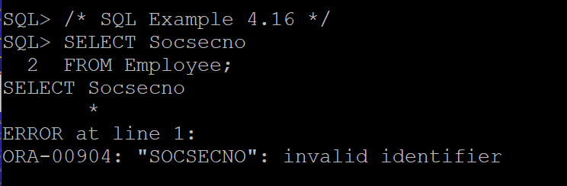
Common Errors – Invalid Column Name
The SELECT statement in SQL Example 4.16 has the employee SSN column name spelled incorrectly.

Slide 5
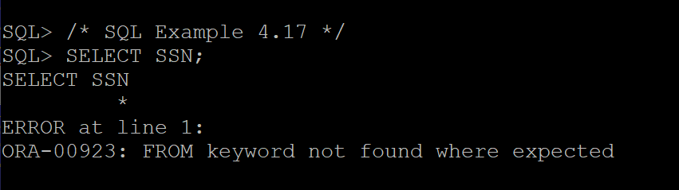
Common Errors – FROM Keyword Missing
This SELECT statement is missing the FROM clause – no table name for retrieving data is given.
Without a table name, the database management system does not know which table to query.

Slide 6
Common Errors – Unknown Command or Invalid Command Structure
In SQL Example 4.18, the order of the SELECT and FROM clauses is reversed.
Oracle is very confused by this command and simply returns an unknown command error message.

Slide 7
Common Errors – Error in Placing Comma
Some types of syntax errors cause Oracle to return error messages that are not particularly helpful in debugging the error or return no error message at all.
In SQL Example 4.19, a comma is missing after the LastName column specification. Instead of reporting that a comma is missing, Oracle produces a result set that is missing one column of data and treats FirstName as a column alias name.
/* SQL Example 4.19 */
SELECT EmployeeID, LastName FirstName
FROM Employee;
EMPLOYEEID FIRSTNAME
---------- ---------------
67555 Simmons
33355 Boudreaux
33344 Adams
more rows will be displayed…

Slide 8
Common Errors – Error in Placing Comma
This example has a comma after the last column name – a simple syntax error.
Oracle expects another column so it reports a missing expression error.
/* SQL Example 4.20 */
SELECT SSN, LastName, FirstName,
FROM Employee;
ERROR at line 2:
ORA-00936: missing expression

Slide 9
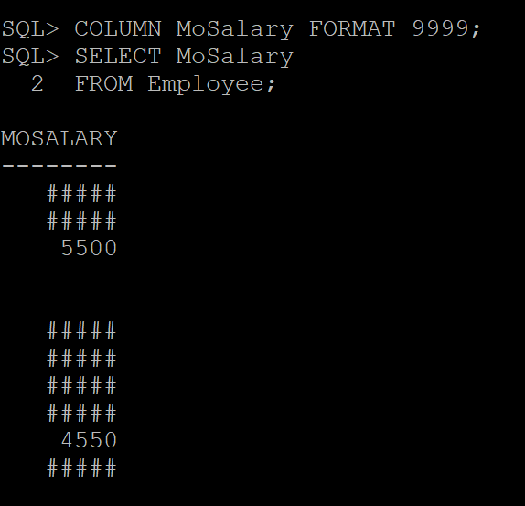
Common Error – Restricting Field to too small a value
If you mistakenly make a field too small using the COLUMN statement, SQL will return the value as ### sign.
If MoSalary is 4 numbers, it shows, MoSalaries of more than 4 digits, show as #.

